Slide 1

(Post-War drama)
The Theatre of the Absurd
SAMUEL BECKETT (1906-1989)
1953/1955
Waiting for Godot

Slide 2
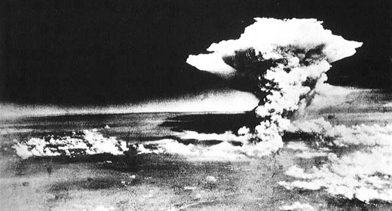
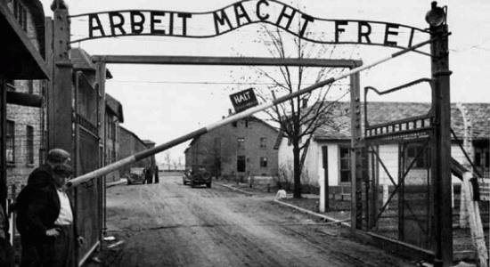
The Theatre of the Absurd and Samuel Beckett
Historical background
The aftermath of World War II increased by the Cold War.
The atrocities of the Nazi concentration camps.
The Allies’ atomic bomb.
Disillusionment coming from the realization that Britain had been reduced to a second-class power.
The nuclear bombing of Hiroshima, 1945
The infamous entrance to Auschwitz.
Only Connect ... New Directions

Slide 3
The Theatre of the Absurd and Samuel Beckett
New meaning of existence
Awareness of man’s propensity to evil and conscience of the destructive power of scientific knowledge.
The lack of moral assurance and the decline of religious faith.
The disillusionment with both the liberal and social theories about economic and social progress.
Mistrust in the power of reason.
A sense of anguish, helplessness and rootlessness developed especially among the young

Slide 4
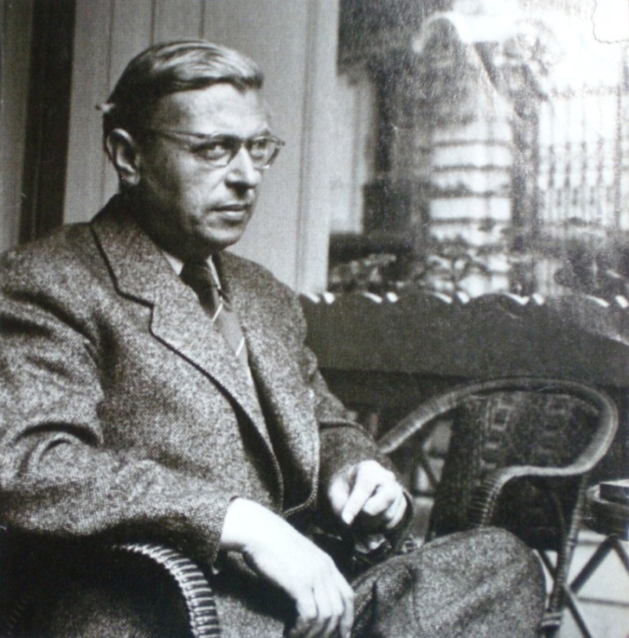
The Theatre of the Absurd and Samuel Beckett
French existentialism
Existentialism saw man trapped in a hostile world.
Human life was meaningless and this created a sense of confusion, despair and emptiness.
The universe was not rational and defied any explanation = ABSURD
The main exponent of this philosophical current was the French Jean Paul Sartre.
Jean Paul Sartre (1905-1980)

Slide 5
POST-WAR DRAMA: GENERAL INTRODUCTION
During the 1950’s= REVIVAL of DRAMA in Britain
showing ➔ REJECTION of TRADITIONAL
VALUES
TWO MAIN TRENDS in new post-war drama:
ANGER and ABSURD

Slide 6
“ANGRY YOUNG MEN”
EDUCATED middle class or working class playwrights (left-wing ideas)
Also called the KITCHEN-SINK DRAMA (squalid setting)
Formally NOT innovative plays  REALISTIC PLAYS
but INNOVATIVE CONTENT STRONG CLASS CONSCIOUSNESS
Frustration of the younger generation who rejected their parents’ middle class values and wanted to expose their unfair situation
Direct/real language of the working class
Attacks against the establishment (the ruling classes and their values)
main exponent = John Osborne – Look back in Anger (1956)

Slide 7
The theatre of the Absurd
Influence of Camus and Sartre (existentialism)
⬇
pessimistic view of man’s existence=
no purpose at all in man’s life, totally absurd
=
After 2 world wars, in a world with no religion, with no belief ➔ Man is lost
?
A BIG existential question
WHAT IS THE PURPOSE OF HUMAN EXISTENCE?

Slide 8
NO MEANING AT ALL
A tragic situation
Beckett’s plays want to represent just this
The absurdity and Irrationality of Human Existence
To represent this …
…he could not follow a realistic form of drama
➔INNOVATIVE FORM

Slide 9
Main THEMES of Beckett’s plays
(influenced by existentialism)
The sense of man’s alienation.
The cruelty of human life.
The absence or the futility of objectives.
The meaninglessness of man’s struggle

Slide 10
The theatre of the Absurd
Term applied to a group of dramatists:
Rumanian Ionesco, Russian Adamov (Beckett met them in Paris) Beckett (the most representative)
but not a “school” (each worked on his own)

Slide 11

First written in French and performed in Paris  En Attendant Godot (1953) (written in a foreign language to maintain the language as simple and detached as possible)
Then translated (by Beckett himself) into English (1954) and performed in London  Waiting for Godot (1955)
General situation of B’s plays
All of his characters ARE TRAPPED by a situation from which they can not escape (buried in earth, in dustbins)

Slide 12
Main features: plot
TRADITIONAL DRAMA
There is a story developing in time
Portrait of society through realistic characters who move in a definite period of time
the audience can identify themeselves with the characters
WAITING FOR GODOT
NO STORY, NO PLOT (static work) nothing happens
The characters interact to fill up their time, pauses and silences are as important as words
They quarrel, they put on or off boots (estragon) or hat (vladimir)
they speak but not to communicate something – they just fill up the time to avoid silence
Emphasis on INNER REALITY (A DRAMA OF THE MIND)

Slide 13
Main features: time
TRADITIONAL
DRAMA
Events narrated in a chronological way, there is a development, a climax, a conclusion
WAITING FOR GODOT
No development in time
No past, no future = the characters do not remember their past or figure out their future
one day similar to the following
Not a beginning not an end (sort of nightmare)
First act almost identical to the second

Slide 14
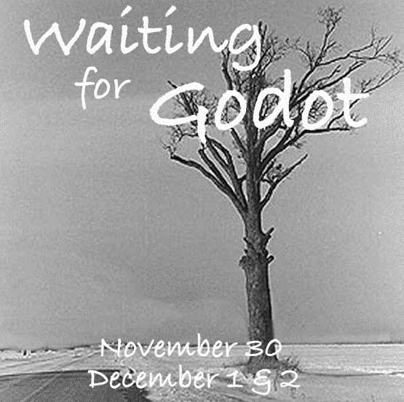
Main features: setting
TRADITIONAL DRAMA
= Realistic setting
and scenery
WAITING FOR GODOT
A country road, a bare tree (everywhere)
Symbolical setting
(expressionism= the representation of the mind and its existential desolation and despair)

Slide 15
Main features:CHARACTERS
Two tramps ESTRAGON (gogo) and VLADIMIR (didi)
Other two tramps POZZO (the boss) and LUCKY (the slave)
The boy announcing the arrival of GODOT (that never comes)
Who is godot?
It may recall the idea of God (In French= Little God)
Go + . (dot) (they want to go but they do not move)
N.B.: Beckett never said it was God
This is what the characters do:
just WAITING FOR GODOT (main theme)
Godot = something/someone that could relieve man from an unbearable situation
But…… GODOT NEVER COMES

Slide 16
Main features: characters
TRADITIONAL
DRAMA
Realistic characters
with their personalities
Belonging to a specific social class
WAITING FOR GODOT
Tramps - No defined personality or social class –
(symbolical of an existential situation)
COMPLEMENTARY
(two different aspects of the same personality = body (gogo) and mind (didi)
they need each other
Vladimir (didi ⇨ dìt dìt – he speaks) ⇨ more intellectual, he plays with his hat
Estragon (gogo ⇨ go,go – problems with his boots) – he has to do with corporal activities (he is angry, sleepy, he always complains he is beaten by someone during the night,)
+
Pozzo (the oppressor/ the power of the body)
Lucky (the slave / the power of the mind, he can speak-when
he has his hat on)
COMPLEMENTARY, too = Linked to each other by a rope, kept by Pozzo (but the in the second act the role is the opposite – Pozzo is blind and needs Lucky who has become dumb)
GODOT The “saviour” or the “saving event” that never comes

Slide 17
Main features: language
TRADITIONAL DRAMA
Realistic,
Characters speak to communicate
WAITING FOR GODOT
Incoherent babbling, puns, gags (language loses its meaning too)
Many PAUSES, MIMING, SILENCES
What happens on the stage is often contradicted by the words spoken by the protagonists
Vladimir “Well, Shall we go?
Estragon “ Yes, let’s go”
[they do not move]

Slide 18
Main features: Style
It is pervaded by a grotesque humour (irony about everything because everything is equally meaningless)
It may be considered a Tragi-comedy
Tragedy= they would like to commit suicide to put an end to their absurd, desperate situation
Comedy= There is no tragic end, they fail, they cannot escape their existential situation
Its tone is tragic and desperate.

Slide 19
Life (1906 -1989)
IRISH - Born in Dublin (Anglo-Irish parents)
Graduated in Modern Languages (French, Italian) at Trinity College, Dublin
1928 Paris (lecturer at Ecole Normale)
Influenced by EXISTENTIALISM (Camus, Sartre)
Met Ionesco and Adamov in Paris
Back to Ireland: Teacher at Trinity College Dublin
1931 (25 years old) ➢ vagabond years across Europe ➢ finally Paris (1936)

Slide 20
…life
World War II ⇨ fought in the Resistance Movement
1945 definetely in Paris (met Joyce)
Wrote in French and English, indifferently
En Attendant Godot = Instant success
He wrote other plays (Endgame, Happy days), critical essays, radio plays.
1969 NOBEL PRIZE for LITERATURE

Slide 21
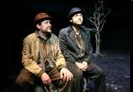

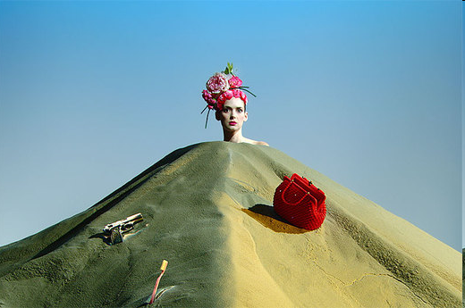
t205 “We’ll come back tomorrow” (from about minute 6 of the video )
FILM (English) http://www.youtube.com/watch?v=TDjgThErfIM
THEATRE (English) http://www.youtube.com/watch?v=X7_g52JrshE t206 “Waiting” (from about minute 1:35 of the video) http://www.youtube.com/watch?v=YELhHkDvwZM&feature=mfu_in_order&list=UL
Miscellaneous scenes from Waiting for Godot
THEATRE (Italian) http://www.youtube.com/watch?v=GBfJaHDDZI8&feature=related
HAPPY DAYS http://www.youtube.com/watch?v=4f9wM-6OLl8&feature=related

